Slide 1
A Unified Approach to Route Planning for Shared Mobility
Yongxin Tong ¹, Yuxiang Zeng ², Zimu Zhou ³, Lei Chen ², Jieping Ye ⁴, Ke Xu ¹ ¹ Beihang University ² The Hong Kong University of Science and Technology ³ ETH Zurich ⁴ Didi Research Institute

Slide 2
Outline
Background and Motivation
Problem Statement
Our Solutions
Experiments
Conclusions
Notes:
Here is the outline of this presentation, I will start with the background and motivation of our paper.

Slide 3
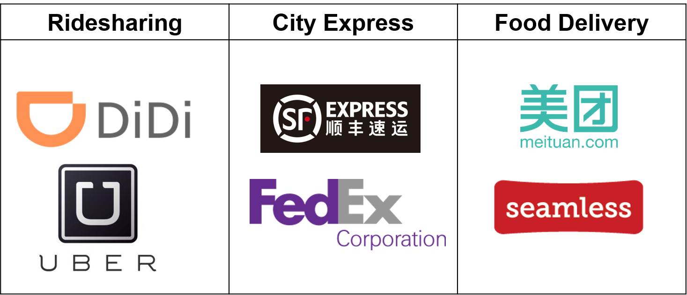
Background: Shared Mobility
Shared mobility: transportation services that are shared among users.
ride sharing, city express, food delivery
Ride Sharing
Notes:
Shared mobility is usually used to indicate the transportation services that are shared among users. A typical applications of shared mobility include ride sharing, city express and food delivery.

Slide 4
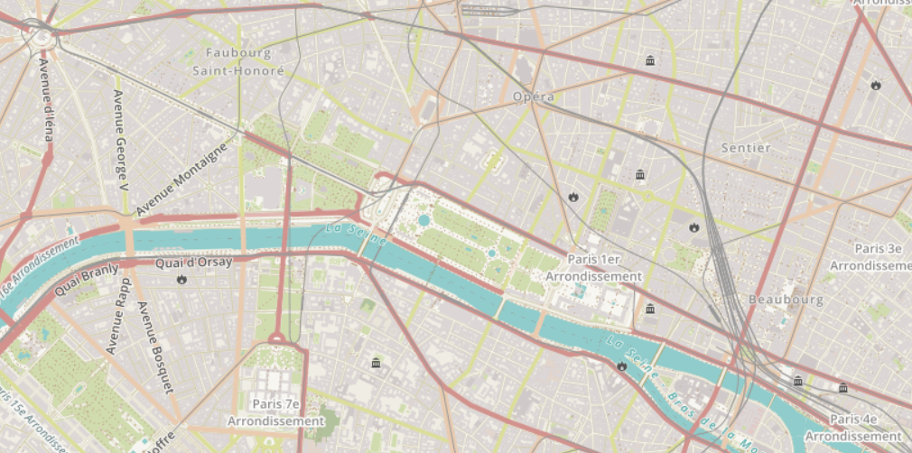

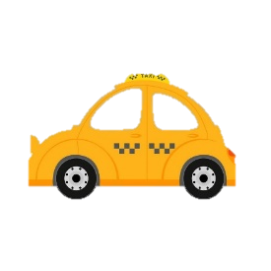


Background: Route Planning
Route Planning for Shared Mobility (RPSM)
start from orgin, travel 2n location
pickup location: the origin of the passenger
delivery location: the destination of the passenger
Constraint: first picked up and then delivered
pickup location
2
delivery
location
1
1
3
3
2
Notes:
Naturally, it raises a research problem behind such applications. That is route planning for shared mobility (RPSM for short).
Let me give you a brief description of RPSM. The most representative feature of the problem is that there will be many pairs of locations, some paper called it OD pair since one of the pair is origin and the other is destination. In ridesharing service, the origin is called pickup location and the destination is called delivery location. There is a natural constraint, that is you must first pick up the passenger and then deliver him/her.

Slide 5
Existing Work
Disadvantage 1:
target on only one goal, even conflict goal
e.g., minimizing total distance while trying to serve all requests [ICDE’13, VLDB’14]
In another word, not all requests need to be served
That is to say, optimal result is 0, i.e., we do not serve any requests
Notes:
Actually, RPSM is also called DARP in transportation science, theory community. First introduced in 1975, but we target on the dynamic scenario, that is, all requests are dynamically arrived in the platform. Actually, there are still many works studying this scenario. We summarize two main disadvantage of these work. The first is they usually target on single objective, even conflict goal.

Slide 6


Existing work
Disadvantage 2:
rely on core operation: Insertion with $O\left(n^{2}\right)$or $O\left(n^{3}\right)$time
Drop D
old route
Pick D
Drop B
new order
Pick A
Drop A
Drop C
Pick BC
Insertion
Drop D
old route
Pick D
Drop B
new route
Pick A
Drop A
Drop C
Pick BC
Notes:
Another disadvantage behind their methodology is that majority of methods rely on one fundamental operation. We call it insertion. Basically, it means we want to insert a new request into the current route of the driver. The time complexity is n square or n cube. It is inefficient for a real-time service.

Slide 7

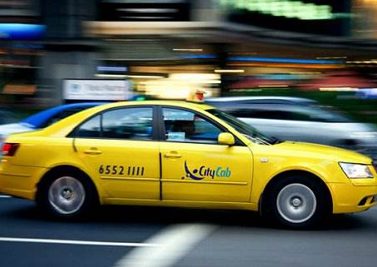

Motivation
We propose a unified cost function, which generalizes three main objectives
Total Travel Distance
Number of served requests
Total Revenue
Notes:
In order to overcome the first limitation, we propose a unified cost function, which can generalize three main objectives. By varying the input parameters, you can total travel distance, maximize the number of served requests or maximize the total revenue.

Slide 8
Outline
Background and Motivation
Problem Statement
Our Solutions
Experiments
Conclusions
Notes:
In this part, let me tell you more about our problem statement.

Slide 9
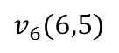
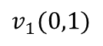
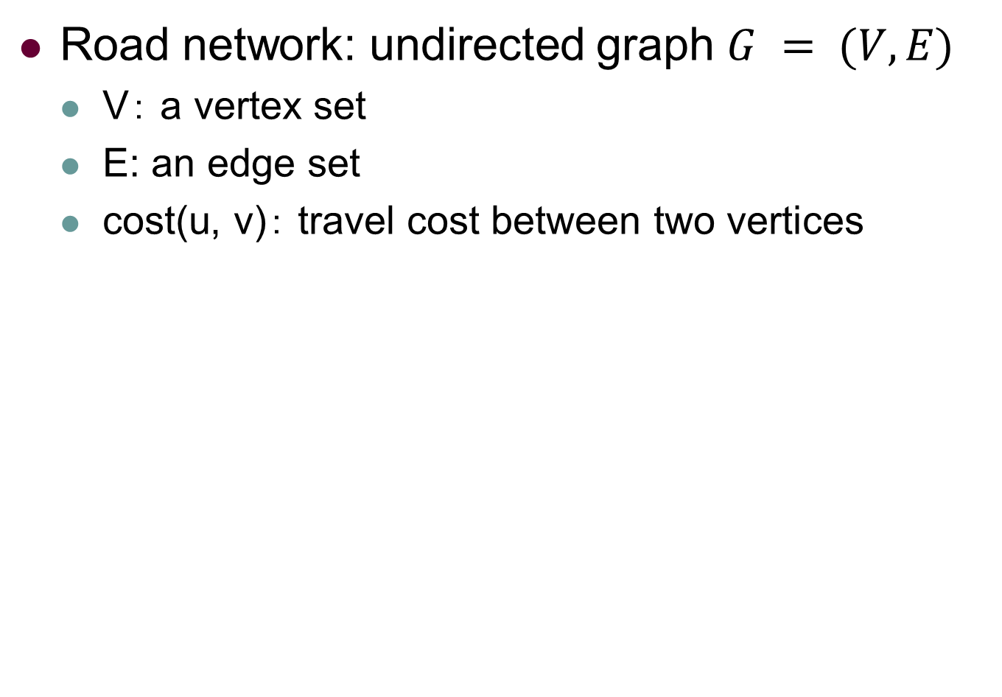
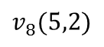
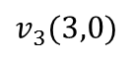
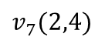
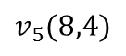
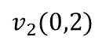
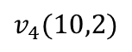
Problem Statement: Road Network
Road network: undirected graph $G = (V, E)$
V： a vertex set
E: an edge set
cost(u, v)： travel cost between two vertices
latitude and longtitude of the vertex
$$v_{6}(6,5)$$
$$v_{7}(2,4)$$
5
3
$$v_{5}(8,4)$$
$$v_{1}(0,1)$$
5
4
3
1
$$v_{8}(5,2)$$
5
$$v_{2}(0,2)$$
5
5
$$v_{4}(10,2)$$
7
8
$$v_{3}(3,0)$$
Notes:
The road network of the input is an undirected graph. Note that each vertex in the road network is usually associated with latitude and longtitude.

Slide 10
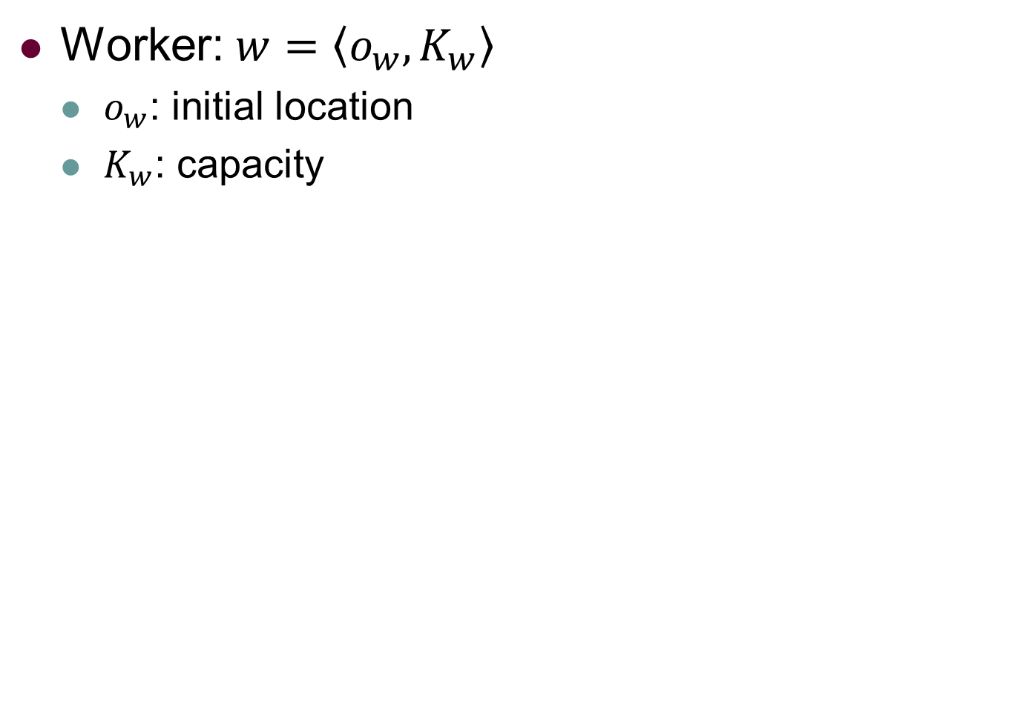
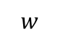
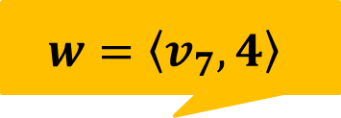
Problem Statement: Worker
Worker: $w=\left\langle o_{w},K_{w}\right\rangle$
$o_{w}$: initial location
$K_{w}$: capacity
$$w=\left\langle v_{7},4\right\rangle$$
$$w_{}$$
$$v_{6}(6,5)$$
$$v_{7}(2,4)$$
5
3
$$v_{5}(8,4)$$
$$v_{1}(0,1)$$
5
4
3
1
$$v_{8}(5,2)$$
5
$$v_{2}(0,2)$$
5
5
$$v_{4}(10,2)$$
7
8
$$v_{3}(3,0)$$
Notes:
Each driver or worker of the platform is associated with an initial location and a capacity.

Slide 11

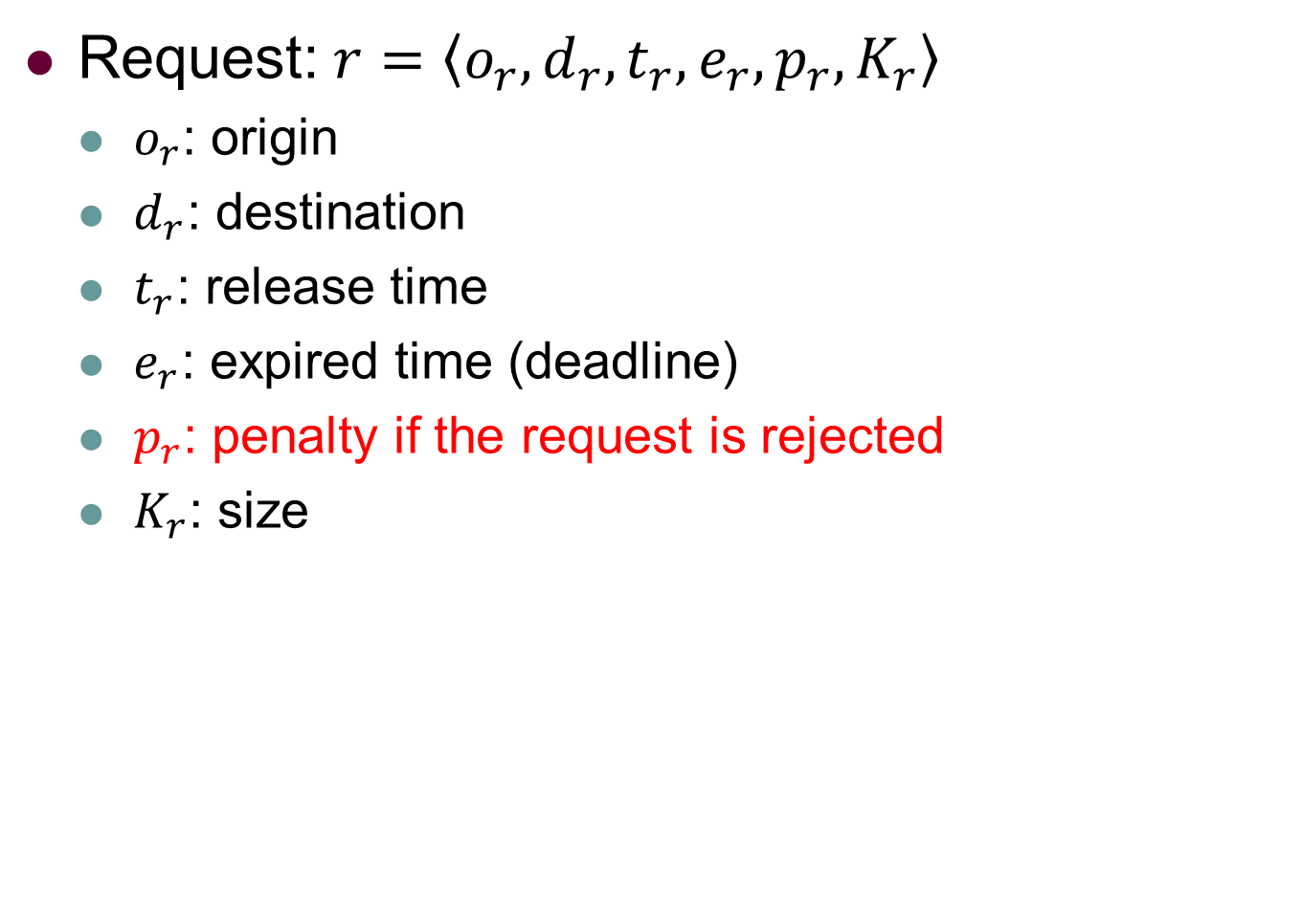
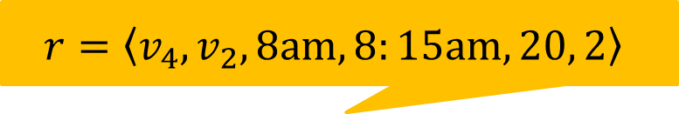
Problem Statement: Request
Request: $r=\left\langle o_{r},d_{r},t_{r},e_{r},p_{r},K_{r}\right\rangle$
$o_{r}$: origin
$d_{r}$: destination
$t_{r}$: release time
$e_{r}$: expired time (deadline)
$p_{r}$: penalty if the request is rejected
$K_{r}$: size
$$r=\left\langle v_{4},v_{2},8am,8:15am,20, 2\right\rangle$$
$$v_{6}(6,5)$$
$$v_{7}(2,4)$$
5
3
$$v_{5}(8,4)$$
$$v_{1}(0,1)$$
5
4
3
1
$$v_{8}(5,2)$$
5
$$v_{2}(0,2)$$
5
5
$$v_{4}(10,2)$$
7
8
$$v_{3}(3,0)$$
Notes:
Each request made by passenger is associated with an origin , a destination, a release time indicates when it is arrived at the platform. an expired time indicating the deadline of the request, a penalty if the request is rejected, a size K indicating how many people there are in this request.

Slide 12
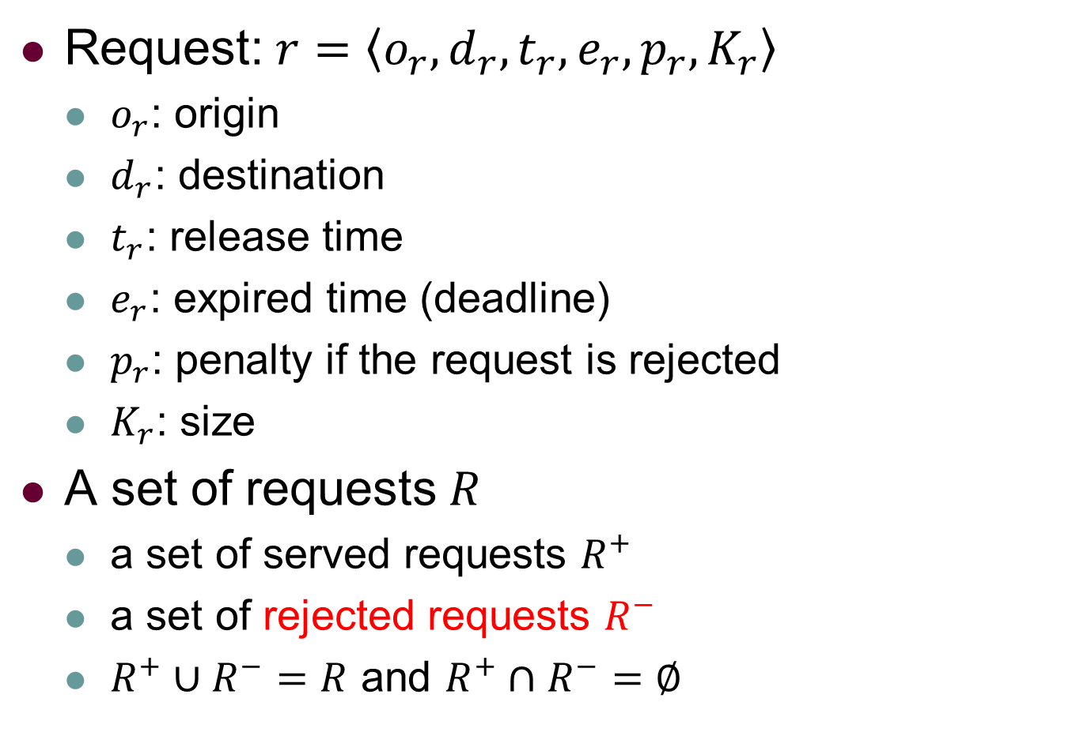
Problem Statement: Request
Request: $r=\left\langle o_{r},d_{r},t_{r},e_{r},p_{r},K_{r}\right\rangle$
$o_{r}$: origin
$d_{r}$: destination
$t_{r}$: release time
$e_{r}$: expired time (deadline)
$p_{r}$: penalty if the request is rejected
$K_{r}$: size
A set of requests $R$
a set of served requests $R^{+}$
a set of rejected requests $R^{−}$
$R^{+}∪R^{−}=R$ and $R^{+}∩R^{−}=∅$
Notes:
For similicity,we use R plus to represent the set of served requests and R minus the represent the set of rejected requests.

Slide 13
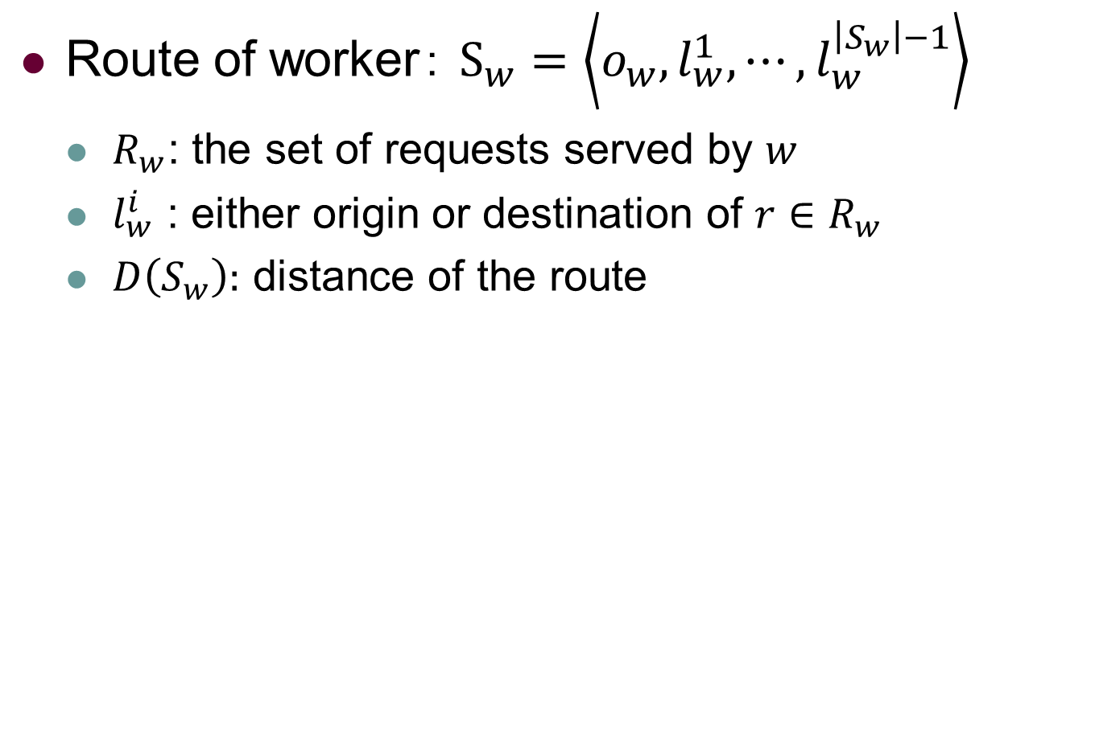
Problem Statement: Route
Route of worker： $S_{w}=\left\langle o_{w},l_{w}^{1},⋯,l_{w}^{\left|S_{w}\right|−1}\right\rangle$
$R_{w}$: the set of requests served by $w$
$l_{w}^{i}$ : either origin or destination of $r∈R_{w}$
$D\left(S_{w}\right):$ distance of the route
Notes:
Accordingly, we can define the route of worker. We use S_w to represent the route which consists of the initial location of the worker and the set of origin and destination of his assigned requests. A route is feasible if both origin and destination appear in the route, the worker reach each destination before its deadline and more important, at any time, the number of …

Slide 14
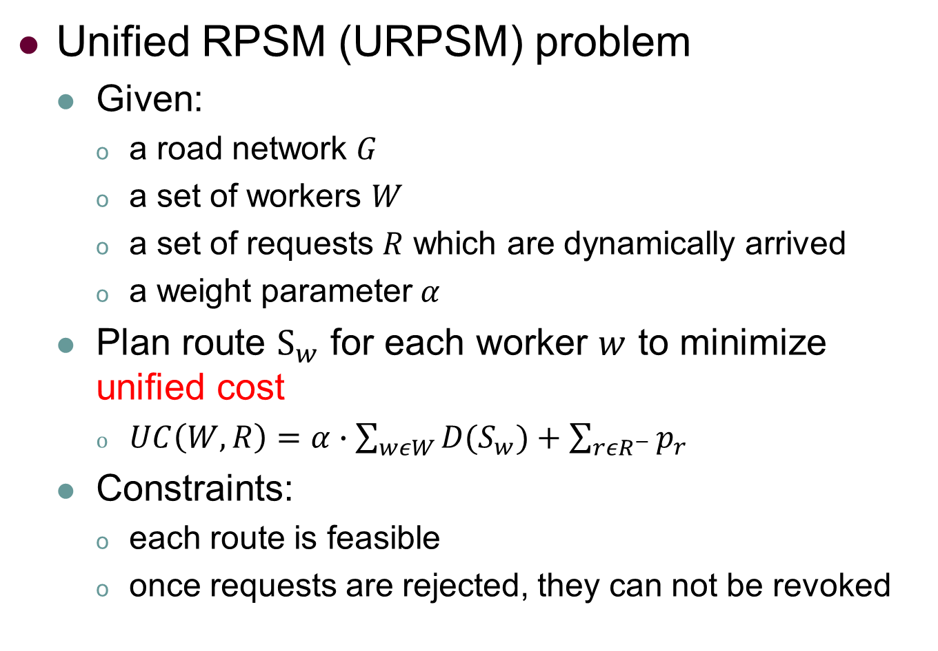
Problem Statement： URPSM
Unified RPSM (URPSM) problem
Given:
a road network $G$
a set of workers $W$
a set of requests $R$ which are dynamically arrived
a weight parameter $α$
Plan route $S_{w}$ for each worker $w$ to minimize unified cost
$UC\left(W,R\right)=α∙\sum_{wεW}{D(S_{w})}+\sum_{rεR^{−}}{p_{r}}$
Constraints:
each route is feasible
once requests are rejected, they can not be revoked
Notes:
Finally, we define our Unified RPSM (URPSM for short) problem as follows. The input includes road network, workers, requests which are dynamically arrived, a weight parameter alpha. We aim to plan a route for each worker to minimize the proposed unified cost function. The first term of the function is weighted total travel cost of all workers, the second term is the total penalty of all rejected requests. Two more constraints are involved. First we need that each route is feasible, Secondly, once requests are rejected, they can not be revoked.

Slide 15

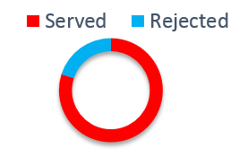

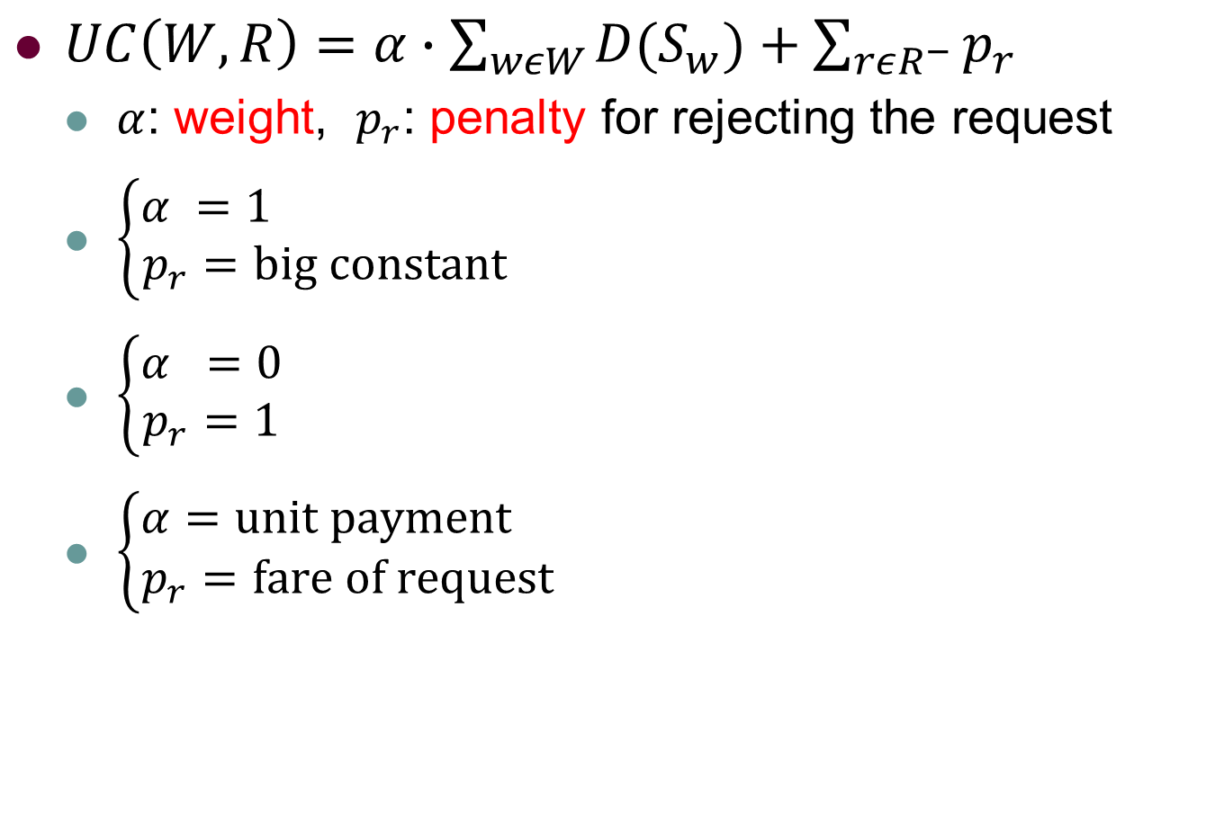
Problem Statement: Unified Cost
$UC\left(W,R\right)=α∙\sum_{wεW}{D(S_{w})}+\sum_{rεR^{−}}{p_{r}}$
$α$: weight, $p_{r}$: penalty for rejecting the request
$\left\{\begin{aligned}α =1 \\ p_{r}=big constant\end{aligned}\right.$
$\left\{\begin{aligned}α =0 \\ p_{r}=1\end{aligned}\right.$
$\left\{\begin{aligned}α=unit payment \\ p_{r}=\text{fare} \text{of} \text{request} \end{aligned}\right.$
Minimize Total Distance
Maximize Served Request
Maximize Total Revenue
Notes:
As I just mentioned before, the unified cost generalize three main different objectives by varying different paramters. There are two terms in the unified cost, the first one is weighted total distance and the other is total penalties of unserved requests. So in order to define minimize total distance, we can alpha to 1, so the first term.

Slide 16

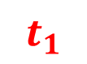
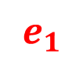
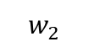
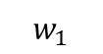
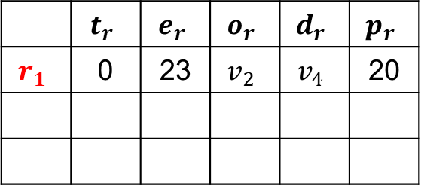
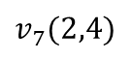
Example
$$w_{1}$$
$$v_{6}(6,5)$$
$$v_{7}(2,4)$$
5
3
$$v_{5}(8,4)$$
$$v_{1}(0,1)$$
5
 | $$t_{r}$$ | $$e_{r}$$ | $$o_{r}$$ | $$d_{r}$$ | $$p_{r}$$
$$r_{1}$$ | 0 | 23 | $$v_{2}$$ | $$v_{4}$$ | 20
4
3
1
$$v_{8}(5,2)$$
5
$$v_{2}(0,2)$$
5
5
$$v_{4}(10,2)$$
7
8
$$w_{2}$$
$$v_{3}(3,0)$$
$$t_{1}$$
$$e_{1}$$
0
23
Notes:
Let me show you a toy example to better show our problem. The figure on the left is a road network and the table on the
right records the information of the request. Since the requests are always dynamically arrived, the first request with origin v_2 and destination v_4 arrives. So currently, you only know the information of this single request, but not all the requests.

Slide 17
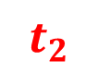
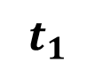
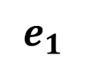
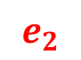
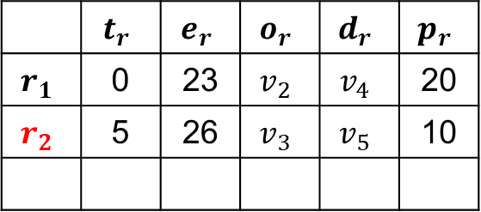
Example
$$w_{1}$$
$$v_{6}(6,5)$$
$$v_{7}(2,4)$$
5
3
$$v_{5}(8,4)$$
$$v_{1}(0,1)$$
5
 | $$t_{r}$$ | $$e_{r}$$ | $$o_{r}$$ | $$d_{r}$$ | $$p_{r}$$
$$r_{1}$$ | 0 | 23 | $$v_{2}$$ | $$v_{4}$$ | 20
$$r_{2}$$ | 5 | 26 | $$v_{3}$$ | $$v_{5}$$ | 10
4
3
1
$$v_{8}(5,2)$$
5
$$v_{2}(0,2)$$
5
5
$$v_{4}(10,2)$$
7
8
$$w_{2}$$
$$v_{3}(3,0)$$
$$t_{1}$$
$$t_{2}$$
$$e_{1}$$
$$e_{2}$$
0
5
23
26
Notes:
Only until time 5, when the second request is released, and the platform would know the information about this request.

Slide 18
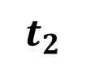
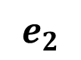
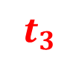
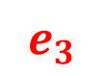
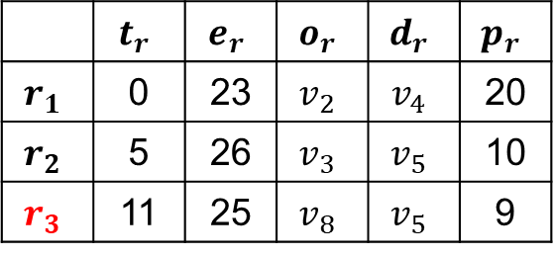
Example
$$w_{1}$$
$$v_{6}(6,5)$$
$$v_{7}(2,4)$$
5
3
$$v_{5}(8,4)$$
$$v_{1}(0,1)$$
5
 | $$t_{r}$$ | $$e_{r}$$ | $$o_{r}$$ | $$d_{r}$$ | $$p_{r}$$
$$r_{1}$$ | 0 | 23 | $$v_{2}$$ | $$v_{4}$$ | 20
$$r_{2}$$ | 5 | 26 | $$v_{3}$$ | $$v_{5}$$ | 10
$$r_{3}$$ | 11 | 25 | $$v_{8}$$ | $$v_{5}$$ | 9
4
3
1
$$v_{8}(5,2)$$
5
$$v_{2}(0,2)$$
5
5
$$v_{4}(10,2)$$
7
8
$$w_{2}$$
$$v_{3}(3,0)$$
$$t_{1}$$
$$t_{2}$$
$$t_{3}$$
$$e_{1}$$
$$e_{3}$$
$$e_{2}$$
0
5
11
23
25
26
Notes:
Similarly, you will only know the information of the last request at time 11. So the challenge of dynamic scenario is that you need to plan route while knowing only partial information.

Slide 19
Outline
Background and Motivation
Problem Statement
Our Solutions
Experiments
Conclusions
Notes:
Next, I will introduce the major part of our solution.

Slide 20
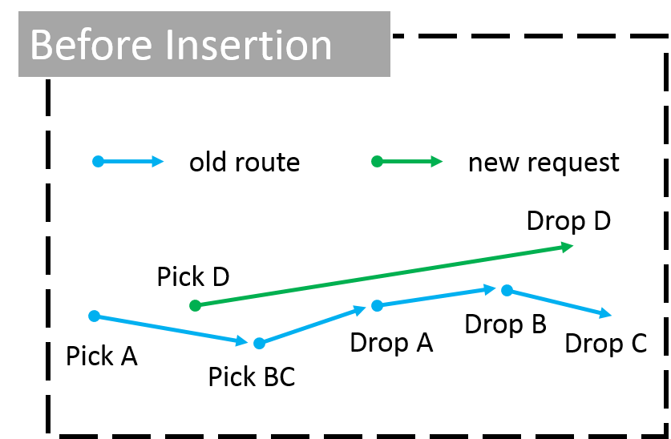
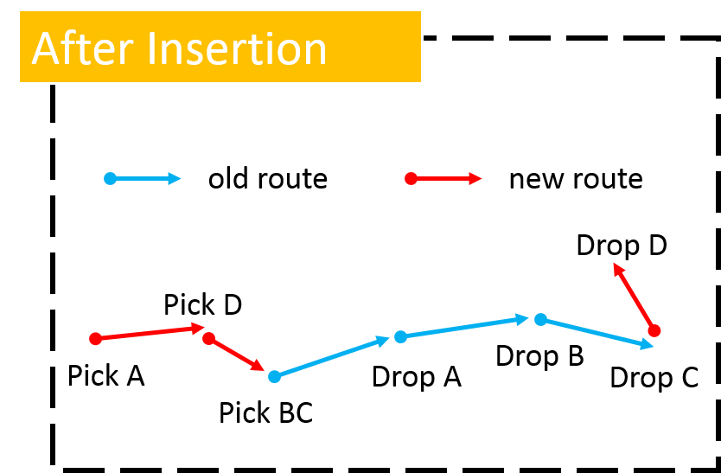
Solution: Insertion
A core operation: Insertion
Given a worker with current route, a new request is inserted into current route with minimal increased distance.
Notes:
In order to overcome the second limitation, you need a fast insertion. The problem is clear, given a worker with his current route, a new request needs to be inserted into current route with minimal increased distance, while the orders of the original requests remain the same. The left figure is an example of the old route with new request. The figure on the right is the new route after inserting the request. Here, insertion is just a description that we plug both origin and destination of the request in the original route.

Slide 21
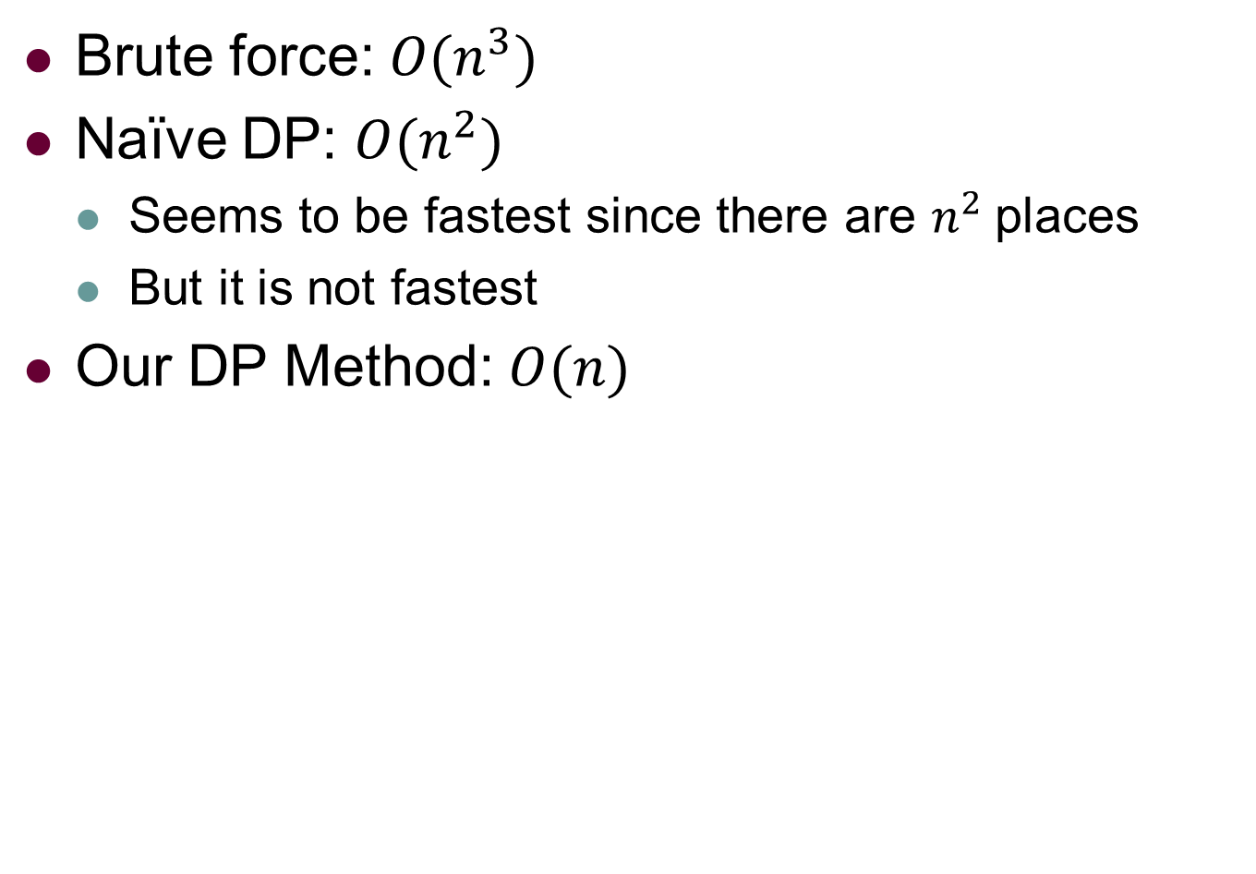
Solution: Insertion
Brute force: $O(n^{3})$
Naïve DP: $O(n^{2})$
Seems to be fastest since there are $n^{2}$places
But it is not fastest
Our DP Method: $O(n)$
Notes:
The good part of insertion is that you can solve it in polynomial time. With brute force, you can solve in cube time. With simple DP, square time. Since there are pairs of places to insertion, it seems that square time is the fastest. However, what we find is that you can implement it in linear time.

Slide 22
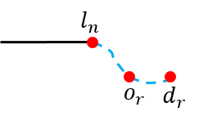
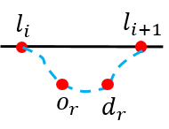
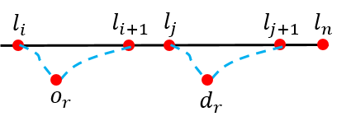
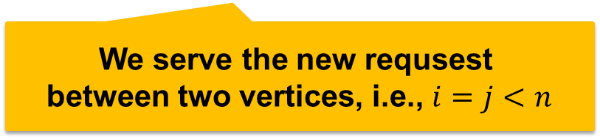
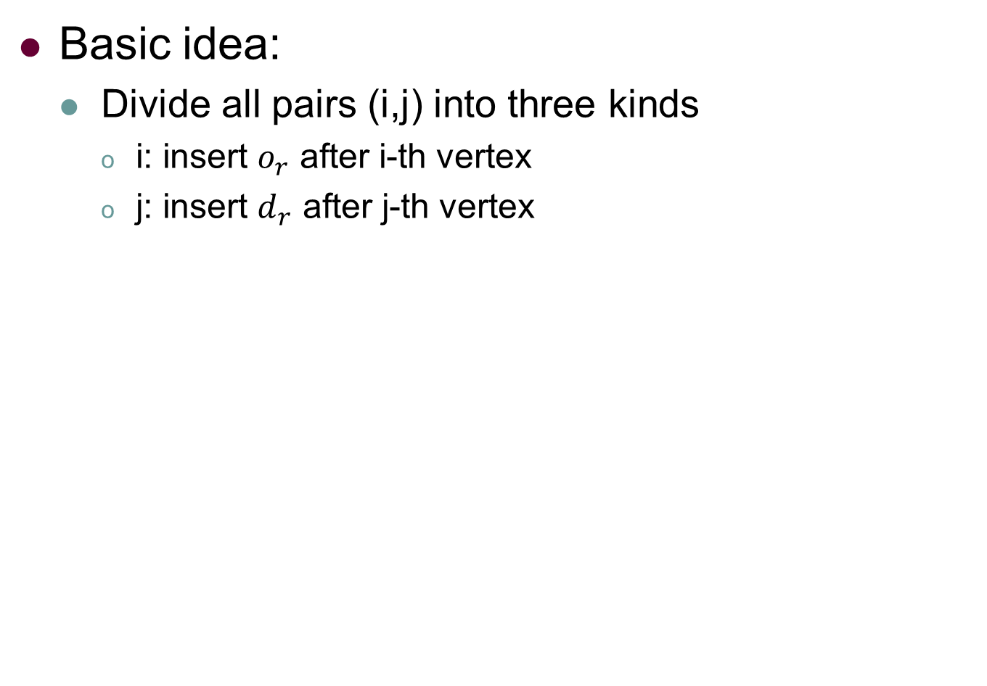

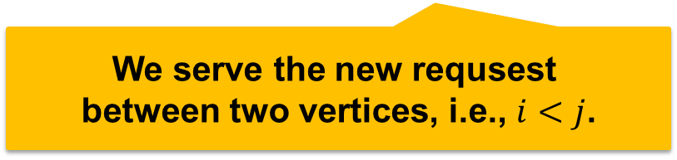
Solution: Linear DP Insertion
Basic idea:
Divide all pairs (i,j) into three kinds
i: insert $o_{r}$ after i-th vertex
j: insert $d_{r}$ after j-th vertex
We serve the new requsest in the end.
i.e., $i=j=n$
We serve the new requsest
between two vertices, i.e., $i=j<n$
We serve the new requsest
between two vertices, i.e., $i<j$.
Notes:
The basic idea of the method is first classify all pairs into three kind. We use i to denote place of inserting new origin and j to denote place to insert new destination. The first two kinds are special. In the first kind, we directly serve the new request in the end, which is i=j=n. In the second kind ,we serve the request between two adjacent vertices, which is i=j<n. The last but not least, is a general kind, which is i < j, it means that both origin and destination are inserted into two different intervals.

Slide 23
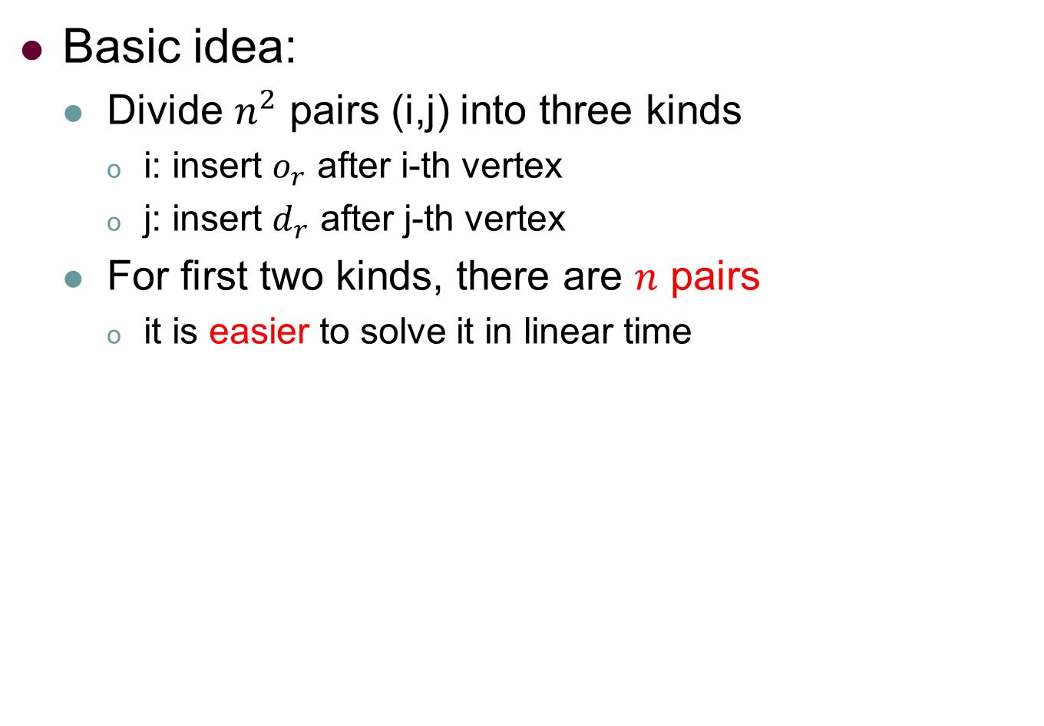
Solution: Linear DP Insertion
Basic idea:
Divide $n^{2}$ pairs (i,j) into three kinds
i: insert $o_{r}$ after i-th vertex
j: insert $d_{r}$ after j-th vertex
For first two kinds, there are $n$ pairs
it is easier to solve it in linear time
Notes:
After the classification, we find there are n pairs in total for the first two kinds, it means that we can easily solve it.

Slide 24
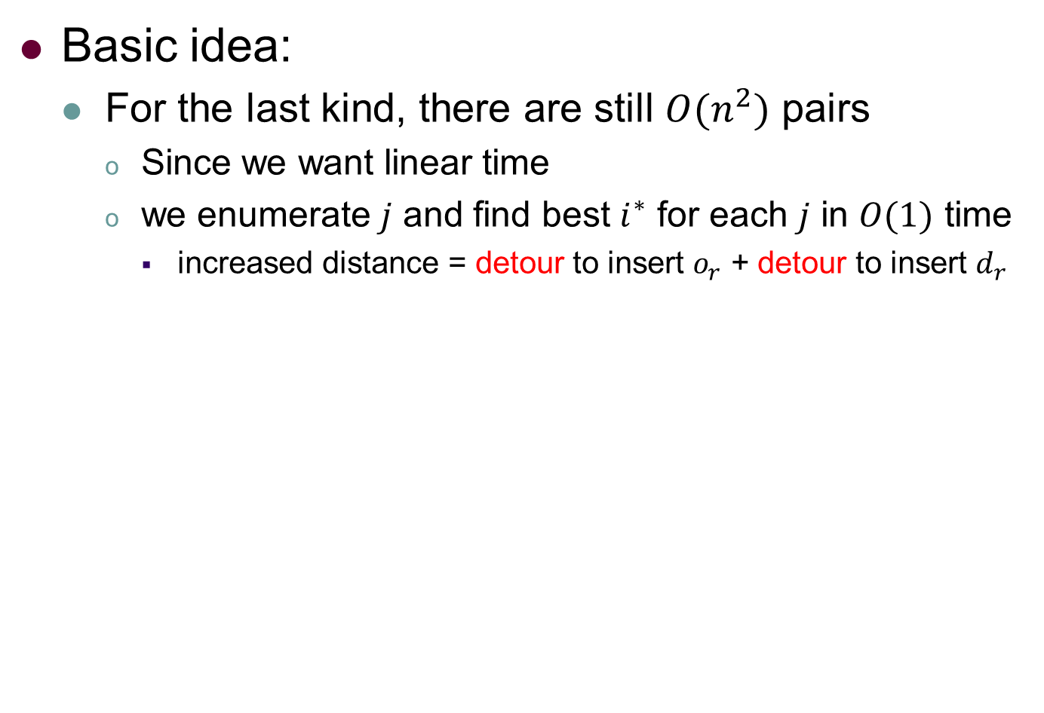




Solution: Linear DP Insertion
Basic idea:
For the last kind, there are still $O(n^{2})$ pairs
Since we want linear time
we enumerate $j$ and find best $i^{∗}$ for each $j$ in $O(1)$ time
increased distance = detour to insert $o_{r}$ + detour to insert $d_{r}$
$$o_{r}$$
$$o_{r}$$
$$o_{r}$$
$$d_{r}$$
Notes:
However, for the last kind, there are still n square pairs. Since we want to solve it in linear time, what we do is we enumerate each possible j and we want to find the best I for each j in O(one) time. In order to achieve this, we first need to calculate the objective of insertion fast. Fortunately, it consists of two parts, both part is related to detour. So the blue line minus the corresponding black line is the length of detour. For a given j, the detour of inserting dr is determined. So we want to find the i* minimize the first part.

Slide 25






Solution: Linear DP Insertion
Basic idea:
For the last case, there are still $O(n^{2})$ pairs
Since we want linear time
we enumerate $j$ and find best $i^{∗}$ for each $j$ in $O(1)$ time
increased distance = detour to insert $o_{r}$ + detour to insert $d_{r}$
$$o_{r}$$
$$o_{r}$$
$$o_{r}$$
$$d_{r}$$
As j increases one,
only one more i.
$$o_{r}$$
$$o_{r}$$
$$o_{r}$$
$$o_{r}$$
$$d_{r}$$
Notes:
If you enumerate each I, you will fall into n square. However, the tricky is if j increases one, there is only one more possible i compared with previous j. Unfortunately, this is only the basic idea, in order to satisfy the capacity of driver and deadline of requests, more math parts should be included. Due to time limit, all the math part please refer to our paper.

Slide 26











Solution: Example
When $r_{1}$ releases, we plan route for $w_{1}$
$S_{w_{1}}=\left\langle v_{7},v_{2},v_{4}\right\rangle$
$$w_{1}$$
$$v_{6}(6,5)$$
$$v_{7}(2,4)$$
5
3
$$v_{5}(8,4)$$
$$v_{1}(0,1)$$
5
4
3
 | $$t_{r}$$ | $$e_{r}$$ | $$o_{r}$$ | $$d_{r}$$ | $$p_{r}$$
$$r_{1}$$ | 0 | 23 | $$v_{2}$$ | $$v_{4}$$ | 20
1
$$v_{8}(5,2)$$
5
$$v_{2}(0,2)$$
5
5
$$v_{4}(10,2)$$
7
8
$$v_{3}(3,0)$$
Notes:
Instead, I will try to use an example to show how to use DP to implement insertion. So, when the first request is arrived, the route is simply planned, that is we first pickup at v_2 and then deliver at v4.

Slide 27



Solution: Example
When $r_{2}$ arrives, $w_{1}$ travels to $v_{1}$
$S_{w_{1}}=\left\langle v_{1},v_{2},v_{4}\right\rangle$
We insert $r_{2}$ into $S_{w_{1}}$
old route
new route
$$v_{6}(6,5)$$
$$w_{1}$$
$$v_{7}(2,4)$$
5
3
$$v_{5}(8,4)$$
$$v_{1}(0,1)$$
5
4
3
 | $$t_{r}$$ | $$e_{r}$$ | $$o_{r}$$ | $$d_{r}$$ | $$p_{r}$$
$$r_{1}$$ | 0 | 23 | $$v_{2}$$ | $$v_{4}$$ | 20
$$r_{2}$$ | 5 | 26 | $$v_{3}$$ | $$v_{5}$$ | 10
1
$$v_{8}(5,2)$$
5
$$v_{2}(0,2)$$
5
5
$$v_{4}(10,2)$$
7
8
$$v_{3}(3,0)$$
Notes:
When the second request is released, we need insertion. The blue line is the original route, and the red line is the shortest path from origin and destination of the new request. We expect that we can insert both red vertices into the route marked by blue but with minimal increased distance.

Slide 28


Solution: Example
Step 1: Initialization
Initializing auxiliary arrays
ddl[k]: deadline to reach k-th vertex
k | 0 ($v_{1}$) | 1 ($v_{2}$) | 2 ($v_{4}$)
ddl | $$∞$$ | 13 | 23
old route
new route
$$v_{6}(6,5)$$
$$w_{1}$$
$$v_{7}(2,4)$$
5
3
$$v_{5}(8,4)$$
$$v_{1}(0,1)$$
5
4
3
 | $$t_{r}$$ | $$e_{r}$$ | $$o_{r}$$ | $$d_{r}$$ | $$p_{r}$$
$$r_{1}$$ | 0 | 23 | $$v_{2}$$ | $$v_{4}$$ | 20
$$r_{2}$$ | 5 | 26 | $$v_{3}$$ | $$v_{5}$$ | 10
1
$$v_{8}(5,2)$$
5
$$v_{2}(0,2)$$
5
5
$$v_{4}(10,2)$$
7
8
$$v_{3}(3,0)$$
Notes:
The first step we need to do is to initialize auxiliary arrays in linear time. They are easy to understand. We first need the deadline to reach each vertex. In another word, if the vertex is a destination, you just set expired time as deadline, otherwise, you can set the expired time minus the shortest travel time between origin and destination. Note some paper require two deadlines, you can just set each value to each condition.

Slide 29


Solution: Example
Step 1: Initialization
Initializing auxiliary arrays
arr[k]: arrival time to reach k-th vertex
k | 0 ($v_{1}$) | 1 ($v_{2}$) | 2 ($v_{4}$)
ddl | $$∞$$ | 13 | 23
arr | 5 | 6 | 16
old route
new route
$$v_{6}(6,5)$$
$$w_{1}$$
$$v_{7}(2,4)$$
5
3
$$v_{5}(8,4)$$
$$v_{1}(0,1)$$
5
4
3
 | $$t_{r}$$ | $$e_{r}$$ | $$o_{r}$$ | $$d_{r}$$ | $$p_{r}$$
$$r_{1}$$ | 0 | 23 | $$v_{2}$$ | $$v_{4}$$ | 20
$$r_{2}$$ | 5 | 26 | $$v_{3}$$ | $$v_{5}$$ | 10
1
$$v_{8}(5,2)$$
5
$$v_{2}(0,2)$$
5
5
$$v_{4}(10,2)$$
7
8
$$v_{3}(3,0)$$
Notes:
We also need the arrival time to each vertex, it can be easily calculated with the distance between vertices.

Slide 30


Solution: Example
Step 1: Initialization
Initializing auxiliary arrays
slack[k]: maximal tolerable time for detour between k-th and (k+1)-th
k | 0 ($v_{1}$) | 1 ($v_{2}$) | 2 ($v_{4}$)
ddl | $$∞$$ | 13 | 23
arr | 5 | 6 | 16
slack | 7 | 7 | $$∞$$
old route
new route
$$v_{6}(6,5)$$
$$w_{1}$$
$$v_{7}(2,4)$$
5
3
$$v_{5}(8,4)$$
$$v_{1}(0,1)$$
5
4
3
 | $$t_{r}$$ | $$e_{r}$$ | $$o_{r}$$ | $$d_{r}$$ | $$p_{r}$$
$$r_{1}$$ | 0 | 23 | $$v_{2}$$ | $$v_{4}$$ | 20
$$r_{2}$$ | 5 | 26 | $$v_{3}$$ | $$v_{5}$$ | 10
1
$$v_{8}(5,2)$$
5
$$v_{2}(0,2)$$
5
5
$$v_{4}(10,2)$$
7
8
$$v_{3}(3,0)$$
Notes:
Based on both arrays, we can calculate slack time, which is the maximal tolerable time for detour between vertices. Basically, slack time is helpful to check whether deadline is violated. It is also a linear dp equation.

Slide 31



Solution: Example
Step 2: Enumeration
Enumerate j (inserting $d_{r}$)
Dio[j]: shortest detour to insert $o_{r}$
Plc[j]: optimal place to insert $o_{r}$
j | 0 ($v_{1}$) | 1 ($v_{2}$) | 2 ($v_{4}$)
ddl | $$∞$$ | 13 | 23
arr | 5 | 6 | 16
slack | 7 | 7 | $$∞$$
Dio | $$∞$$
Plc | $$NIL$$
$Dio\left[0\right]=∞$ and $Plc[0]=NIL$,
since $j$ must be larger than 0 (otherwise $i < j= 0$).
old route
new route
$$v_{6}(6,5)$$
$$w_{1}$$
$$v_{7}(2,4)$$
5
3
$$v_{5}(8,4)$$
$$v_{1}(0,1)$$
5
4
3
 | $$t_{r}$$ | $$e_{r}$$ | $$o_{r}$$ | $$d_{r}$$ | $$p_{r}$$
$$r_{1}$$ | 0 | 23 | $$v_{2}$$ | $$v_{4}$$ | 20
$$r_{2}$$ | 5 | 26 | $$v_{3}$$ | $$v_{5}$$ | 10
1
$$v_{8}(5,2)$$
5
$$v_{2}(0,2)$$
5
5
$$v_{4}(10,2)$$
7
8
$$v_{3}(3,0)$$
Notes:
In the next part, we will enumerate each j and find optimal detour for inserting origin in constant. We use Dio to denote that value and Plc to denote the corresponding place to insert origin. When j = 0, we set them with inifity and null to denote these is no feasible solution, since I is less than j no smaller than 0.

Slide 32



Solution: Example
Step 2: Enumeration
Enumerate j (inserting $d_{r}$)
Dio[j]: shortest detour to insert $o_{r}$
Plc[j]: optimal place to insert $o_{r}$
j | 0 ($v_{1}$) | 1 ($v_{2}$) | 2 ($v_{4}$)
ddl | $$∞$$ | 13 | 23
arr | 5 | 6 | 16
slack | 7 | 7 | $$∞$$
Dio | $$∞$$ | $$∞$$
Plc | $$NIL$$ | $$NIL$$
old route
As $j$ increases one, there is one more possible $i$.
But, $det\left(v_{1},o_{r},v_{2}\right)=\left(1+7\right)+7−1=14>slack[0]$.
Thus, we set $Dio\left[1\right]= Dio\left[0\right]= ∞, Plc\left[1\right]=NIL.$
new route
$$v_{6}(6,5)$$
$$w_{1}$$
$$v_{7}(2,4)$$
5
3
$$v_{5}(8,4)$$
$$v_{1}(0,1)$$
5
4
3
 | $$t_{r}$$ | $$e_{r}$$ | $$o_{r}$$ | $$d_{r}$$ | $$p_{r}$$
$$r_{1}$$ | 0 | 23 | $$v_{2}$$ | $$v_{4}$$ | 20
$$r_{2}$$ | 5 | 26 | $$v_{3}$$ | $$v_{5}$$ | 10
1
$$v_{8}(5,2)$$
5
$$v_{2}(0,2)$$
5
5
$$v_{4}(10,2)$$
7
8
$$v_{3}(3,0)$$
Notes:
When j increases one to 1, it means that destination is inserted between v2 and v4. There is one more possible i, which is inserting origin between v_1 and v_2. So the detour of inserting origin is 14, which is larger than the slack time of zero. It means some of the deadline will be violated. So there is no feasible i.

Slide 33











Solution: Example
Step 2: Enumeration
Enumerate j (inserting $d_{r}$)
Dio[j]: shortest detour to insert $o_{r}$
Plc[j]: optimal place to insert $o_{r}$
j | 0 ($v_{1}$) | 1 ($v_{2}$) | 2 ($v_{4}$)
ddl | $$∞$$ | 13 | 23
arr | 5 | 6 | 16
slack | 7 | 7 | $$∞$$
Dio | $$∞$$ | $$∞$$ | 5
Plc | $$NIL$$ | $$NIL$$ | 1
old route
old route
As $j$ increases to 2, there is one more possible $i$.
But, $det\left(v_{2},o_{r},v_{4}\right)=7+8−10=5<slack[1]$.
Thus, we set $Dio\left[2\right]=min\{Dio\left[1\right],5\}=5, Plc\left[1\right]=i.$
new route
$$v_{6}(6,5)$$
new route
$$v_{6}(6,5)$$
$$w_{1}$$
$$w_{1}$$
$$v_{7}(2,4)$$
$$v_{7}(2,4)$$
5
5
3
3
$$v_{5}(8,4)$$
$$v_{5}(8,4)$$
5
$$v_{1}(0,1)$$
5
$$v_{1}(0,1)$$
4
 | $$t_{r}$$ | $$e_{r}$$ | $$o_{r}$$ | $$d_{r}$$ | $$p_{r}$$
$$r_{1}$$ | 0 | 23 | $$v_{2}$$ | $$v_{4}$$ | 20
$$r_{2}$$ | 5 | 26 | $$v_{3}$$ | $$v_{5}$$ | 10
4
3
3
$$v_{8}(5,2)$$
1
$$v_{8}(5,2)$$
1
5
5
5
$$v_{2}(0,2)$$
5
$$v_{2}(0,2)$$
5
$$v_{4}(10,2)$$
5
$$v_{4}(10,2)$$
7
7
8
8
$$v_{3}(3,0)$$
$$v_{3}(3,0)$$
Notes:
When j increases one more, it means we insert destination in the end. Similarly, there is still one more possible I, it means we insert origin between v2 and v4. This time, when you calculate the detour of inserting origin, the value is 5, less than the slack time. Finally, we get a feasible pair of insertion. Note, this is only the toy example. Many more constraints need to be checked, all details refer to our paper.

Slide 34

Solution: Framework
Notes:
The other good part of insertion is you can design your objective, previously, we want to insertion with minimal increased distance, we already at least three different objectives, including weighted sum, max operator. It all works. What’s more, you can easily built a framework upon the insertion.

Slide 35
Outline
Background and Motivation
Problem Statement
Our Solutions
Experiments
Conclusions
Notes:
In experiments part,

Slide 36
Experiment: Setup
Datasets: Bigger (6.6x~11.1x) and More (1.5x)
Chengdu: collected by Didi Chuxing, open dataset
https://outreach.didichuxing.com/research/opendata/
NYC: collected in New York city, open dataset
Baseline:
tshare: [ICDE’13]
kinetic: [VLDB’14, ICDE’17, ICDE’18]
batch: a batch-base method from [PNAS’17]
GreedyDP: our method without pruning
pruneGreedyDP: our method
Notes:
We use bigger road network and more requests than any of the other studies. All the dataset is open dataset. We choose threestate-of-the-arts as baseline, specifically, tshare is from ICDE’13, kinetic is from VLDB’14, which is used by many papers, ICDE17,18, ijcai16. And another batch-based method, which is extended from pnas’17. In order to test our pruning strategy, we also add another baseline called greedyDP to compare with our method, pruneGreedyDP.

Slide 37


Experiment: Result
Unified cost
1.2x to 12.8x lower.
ours
1.23x
9.33x
Notes:
In terms of unified cost, our method is 1.2 to 12.8 times lower, which is better since we want to minimize the cost.

Slide 38

Experiment: Result
Served Rate: percentage of served requests
9% higher.
ours
59.3%
9.1%
Notes:
In terms of served rate, which is the percentage of served requests among all requests, our method is at least 9% higher.

Slide 39

Experiment: Result
Response time:
2.62x to 20.72x faster.
Pruning makes our method 2.76x faster
ours
Kinetic can not finish in 24 hours.
22.6x
6.58x
2.76x
Pruning saves 22.26~45.16 billion shortest distance query.
Notes:
In terms of response time, which is the average time to response each request, our method is usually 2.6 to 20.7 times faster. Kinetic is sometims can not finish in 24 hours when the capacity is larger, number of worker is larger. Our method is also 2.7 faster the method without pruning, due to 22 to 45 billions of distance queries saved.

Slide 40
Outline
Background and Motivation
Problem Statement
Our Solutions
Experiments
Conclusions
Notes:
Finally, here is the conclusion of paper.

Slide 41
Conclusion
Abstract a unified formulation of the route planning problem for shared mobility, URPSM problem.
Design a novel dynamic programming (DP) algorithm to accelerate the core operation, insertion.
Our framework is 2.6 to 20.7 times faster and 1.2 to 12.8 times more effective than the state-of-the-arts.
Notes:
We first propose a well defined problem with unified cost function, we then propose an DP based insertion, its basic is very general. Finally, in experiments, our method is up to 20 times faster and 12 times more effective than the state-of-the-arts.

Slide 42

Q & A
Thank You
Notes:
So this is all for the presentation, we are welcoming any questions.

Slide 43

Problem Statement: Route
Route of worker： $S_{w}=\left\langle o_{w},l_{w}^{1},⋯,l_{w}^{\left|S_{w}\right|−1}\right\rangle$
$R_{w}$: the set of requests served by $w$
$l_{w}^{i}$ : either origin or destination of $r∈R_{w}$
A route is feasible if
$∀r∈R_{w}$, both origin and destination are in $S_{w}$
worker arrives at $d_{r}$ no later than deadline $e_{r}$
at any time, the number of requests have been picked by not delivered does not exceed capacity of worker
Notes:
Accordingly, we can define the route of worker. We use S_w to represent the route which consists of the initial location of the worker and the set of origin and destination of his assigned requests. A route is feasible if both origin and destination appear in the route, the worker reach each destination before its deadline and more important, at any time, the number of …

Slide 44

Solution: Linear DP Insertion
Basic idea:
dynamic programming with (2n+1) shortest distance query
Notes:
Due to limit time, I will not introduce the details of math, instead, I list the DP equations here. We also emphasis that the number of shortest distance query is limited to (2n+1). And we assume that this number should be the as least as possible.

Slide 45











Solution: Example
Step 1: Initialization
Initializing auxiliary arrays using DP
picked[k]: number of picked requests at k-th vertex
 | 0 | 1 | 2
ddl | $$∞$$ | 13 | 23
arr | 5 | 6 | 16
picked | 0 | 1 | 0
old route
new route
$$v_{6}(6,5)$$
$$w_{1}$$
$$v_{7}(2,4)$$
5
3
$$v_{5}(8,4)$$
$$v_{1}(0,1)$$
5
4
3
 | $$t_{r}$$ | $$e_{r}$$ | $$o_{r}$$ | $$d_{r}$$ | $$p_{r}$$
$$r_{1}$$ | 0 | 23 | $$v_{2}$$ | $$v_{4}$$ | 20
$$r_{2}$$ | 5 | 26 | $$v_{3}$$ | $$v_{5}$$ | 10
1
$$v_{8}(5,2)$$
5
$$v_{2}(0,2)$$
5
5
$$v_{4}(10,2)$$
7
8
$$v_{3}(3,0)$$

Slide 46
Solution: Linear DP Insertion
Basic idea:
dynamic programming with (2n+1) shortest distance query
(2n+1) distance query
old route
new request
n queries: from new drop to others
shortest distance query
Drop D
n queries: from new pick to others
Pick D
1 query: the length of new request
Drop B
Pick A
Drop A
Drop C
Pick BC
Notes:
The reason is as follows. First you need to query the shortest distance between source of new request to all vertexes, which includes n queries.
You also need to query the shortest distance between destination of new request to all vertexes, which is also n queries.
In the end, the length of both origin and destination in the new request should also be calculated. Thus, there are 2n+1 queries in total. Theoretically, the number of queries should not be less than this under the definition of insertion.

Slide 47


Slide 48


Slide 49


